Slide 1
数 据 库 原 理
Chp 14 Indexing
王 建 民
清 华 大 学 软 件 学 院
2023年/春

Slide 2
本节课的内容
理论 | 核心知识点 | 对应章节
数据库理论 | 关系模型、关系代数、关系演算 | CHP. 1、2
数据库应用 | SQL语言、JDBC | CHP 3、4、5
数据库设计 | 实体-联系图、关系范式 | CHP 6、7
数据库实现 | 存贮、索引、查询、优化、 事务、并发、恢复 | CHP 12、13、14（24.3/24.5）、15、 16、17、18、19

Slide 3
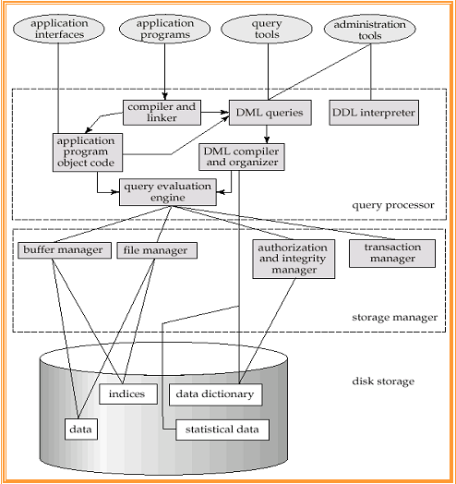
DBMS Architecture

Slide 4
为什么需要索引?
Many queries reference only a small proportion of the records in a file.
“Find all instructors in the Physics department”
“Find the total number of credits earned by the student with ID 22201”
Ideally, the system should be able to locate these records directly.

Slide 5
Contents
Basic Concepts（14.1）
Ordered Indices （14.2）
B+-Tree Index Files（14.3）
B+-Tree File Organization（14.4.1）
Static Hashing（14.5）
Dynamic Hashing（24.5）
Comparison of Ordered Indexing and Hashing
Bitmap Indices（14.9/24.3）
Index Definition in SQL（14.7）

Slide 6
查找键与索引文件
Indexing mechanisms used to speed up access to desired data. E.g., author catalog in library
Search Key(查找键) - attribute or set of attributes used to look up records in a file.
An index file(索引文件) consists of records (called index entries, 索引项) of the form
Index files are typically much smaller than the data files(数据文件）
search-key
pointer
Notes:
第十章我们讨论的都是data files， 这一章我们讨论的是index files

Slide 7
顺序索引与哈希索引
Ordered indices
search keys are stored in sorted order
Hash indices
search keys are distributed uniformly across “buckets” using a “hash function”
Notes:
第十章我们讨论的都是data files， 这一章我们讨论的是index files

Slide 8
索引评价指标
Access types supported efficiently. E.g.,
records with a specified value in the attribute
or records with an attribute value falling in a specified range of values.
Time
Access time
Insertion time
Deletion time
Space overhead

Slide 9
Contents
Basic Concepts
Ordered Indices
B+-Tree Index Files
B+-Tree File Organization
Static Hashing
Dynamic Hashing
Comparison of Ordered Indexing and Hashing
Bitmap Indices
Index Definition in SQL

Slide 10
顺序索引
In an ordered index, index entries are sorted on the search key value. E.g., author catalog in library.
Primary index: in a sequentially ordered file, the index whose search key specifies the sequential order of the file.
Also called clustering index（注意 前一章 Multitable Clustering File）
The search key of a primary index is usually but not necessarily the primary key.
Secondary index: an index whose search key specifies an order different from the sequential order of the file.
Also called non-clustering index.

Slide 11
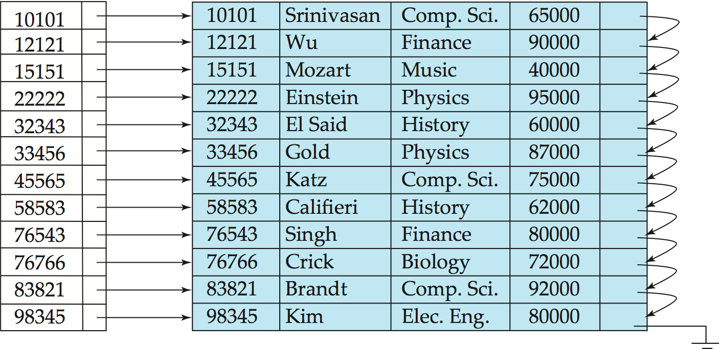
密集索引
Dense index — Index record appears for every search-key value in the data file. E.g. dense index on ID attribute of instructor relation
Index-sequential file: ordered sequential data file with a primary index.

Slide 12
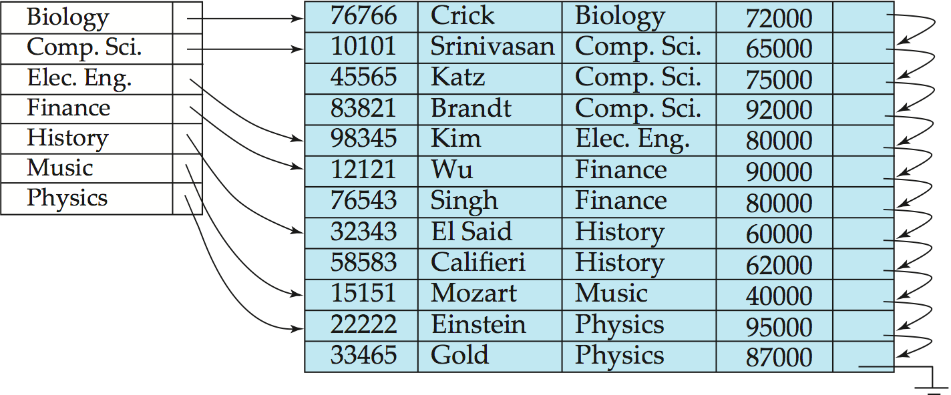
密集索引项不一定对应每个元组
Dense index on dept_name, with instructor file sorted on dept_name
密集索引项的数量等于索引属性的取值数量

Slide 13
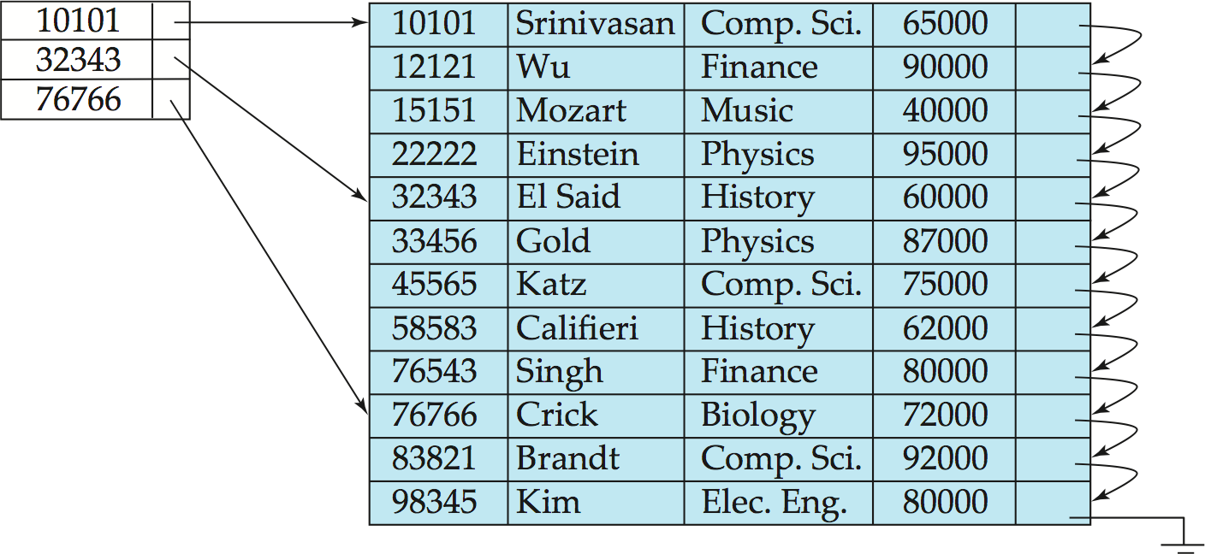
稀疏索引
Sparse Index: contains index records for only some search-key values.
Applicable when records are sequentially ordered on search-key（必要条件）
To locate a record with search-key value K we:
Find index record with largest search-key value < K
Search data file sequentially starting at the record to which the index record points
Step 1
Step 2
Suppose K=45565

Slide 14
稀疏索引的实现策略
Compared to dense indices:
Less space and less maintenance overhead for insertions and deletions.
Generally slower than dense index for locating records.
Good tradeoff: sparse index with an index entry for every block in data file, corresponding to least (最小）search-key value in the block.

Slide 15
次级索引
Frequently, one wants to find all the records whose values in a certain field (which is not the search-key of the primary index) satisfy some condition.
Example 1: In the instructor relation stored sequentially by ID, we may want to find all instructors in a particular department
Example 2: as above, but where we want to find all instructors with a specified salary or with salary in a specified range of values
We can have a secondary index with an index record for each search-key value

Slide 16
次级索引举例
Secondary index on salary field of instructor
Index record points to a bucket that contains pointers to all the actual records with that particular search-key value.
Secondary indices have to be dense
Notes:
16
此bucket并不是Hash Bucket

Slide 17
索引与次级索引的代价
Indices offer substantial benefits when searching for records.
BUT:
Updating indices imposes overhead on database modification --when a file is modified, every index on the file must be updated,
Sequential scan using primary index is efficient, but a sequential scan using a secondary index is expensive
Each record access may fetch a new block from disk
Block fetch requires about 5 to 10 milliseconds（毫秒）, versus about 100 nanoseconds（纳秒） for memory access
Notes:
17

Slide 18
多级索引
If primary index does not fit in memory, access becomes expensive.
Solution: treat primary index kept on disk as a sequential file and construct a sparse index on it.
outer index – a sparse index of primary index
inner index – the primary index file
If even outer index is too large to fit in main memory, yet another level of index can be created, and so on.
Indices at all levels must be updated on insertion or deletion from the file.

Slide 19
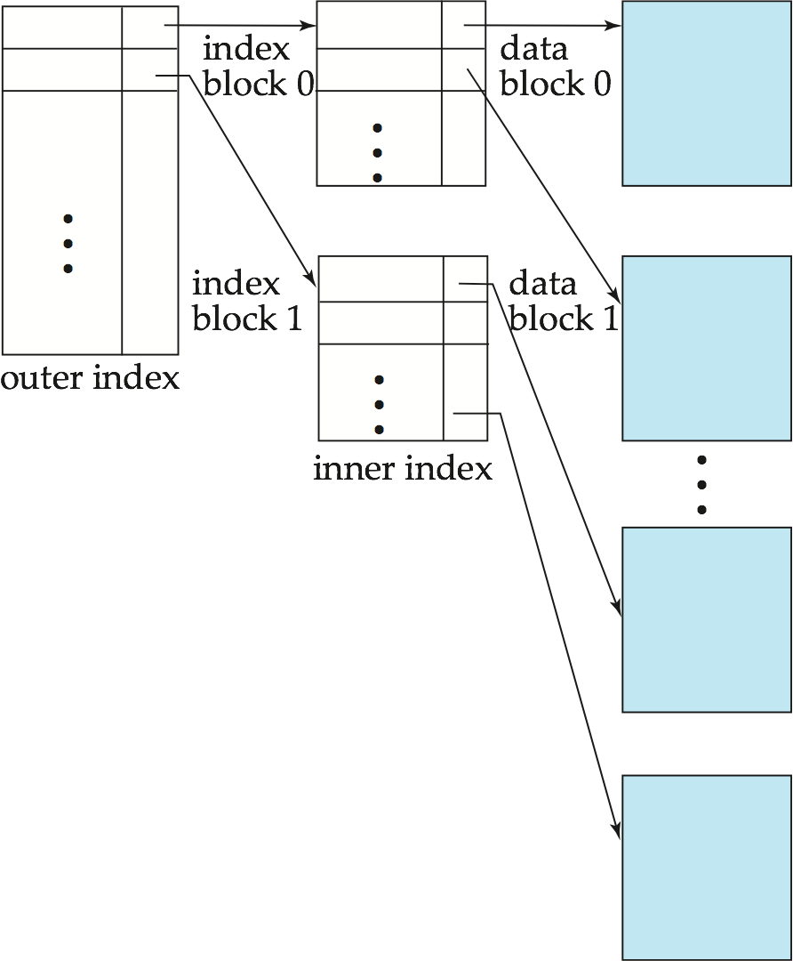
多级所引举例

Slide 20
单层索引节点删除
the index file
the data file
If deleted record was the only record in the data file with its particular search-key value, the search-key is deleted from the index file also.
Dense indices – deletion of search-key is similar to file record deletion.
Sparse indices –
if an entry for the search key exists in the index, it is deleted by replacing the entry in the index with the next search-key value in the data file (in search-key order).
If the next search-key value already has an index entry, the entry is deleted instead of being replaced.

Slide 21
单层索引节点插入
In the index file, perform a lookup using the search-key value appearing in the record to be inserted.
Dense indices – if the search-key value does not appear in the index, insert it.
Sparse indices – if index stores an entry for each block of the file, no change needs to be made to the index unless a new block is created.
If a new block is created, the first search-key value appearing in the new block is inserted into the index.

Slide 22
Contents
Basic Concepts
Ordered Indices
B+-Tree Index Files
B+-Tree File Organization
Static Hashing
Dynamic Hashing
Comparison of Ordered Indexing and Hashing
Bitmap Indices
Index Definition in SQL

Slide 23
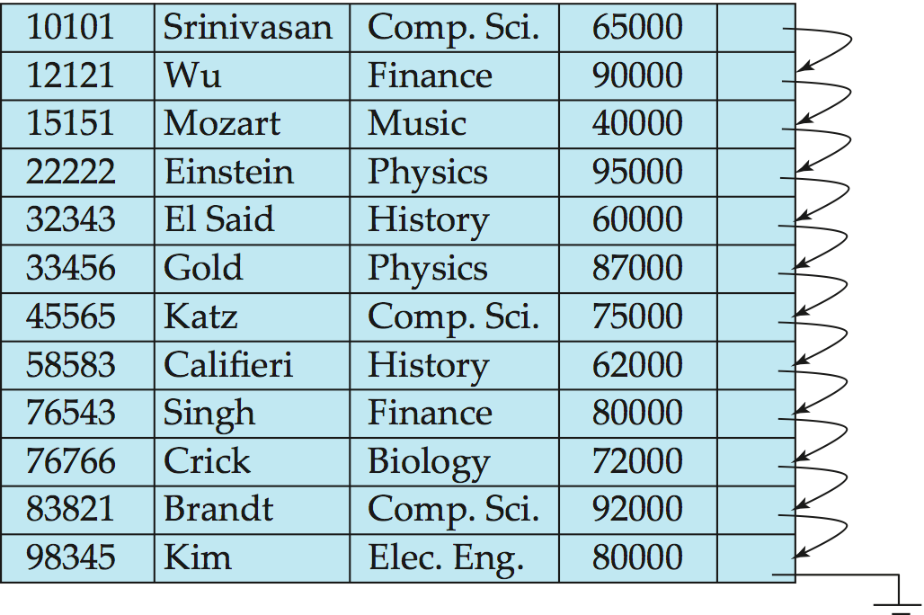
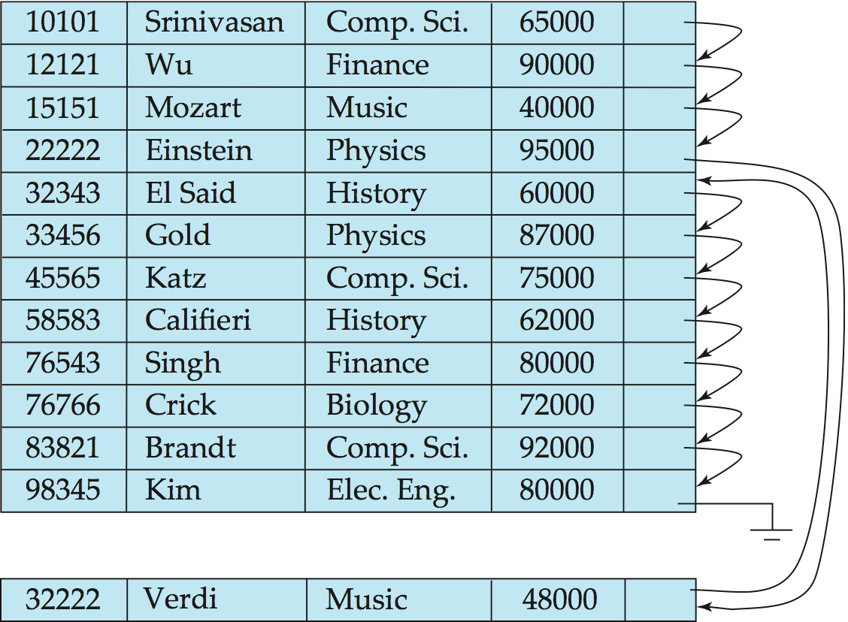
Overflow in sequential data files
performance degrades as file grows, since many overflow blocks get created in the sequential data file
Periodic reorganization of entire file is required.
overflow blocks

Slide 24
B⁺树索引文件
Advantage of B⁺-tree index files:
automatically reorganizes itself with small, local, changes, in the face of insertions and deletions.
Reorganization of entire file is not required to maintain performance.
(Minor) disadvantage of B⁺-trees:
extra insertion and deletion overhead, space overhead.
B+-tree indices are an alternative to indexed-sequential files.

Slide 25
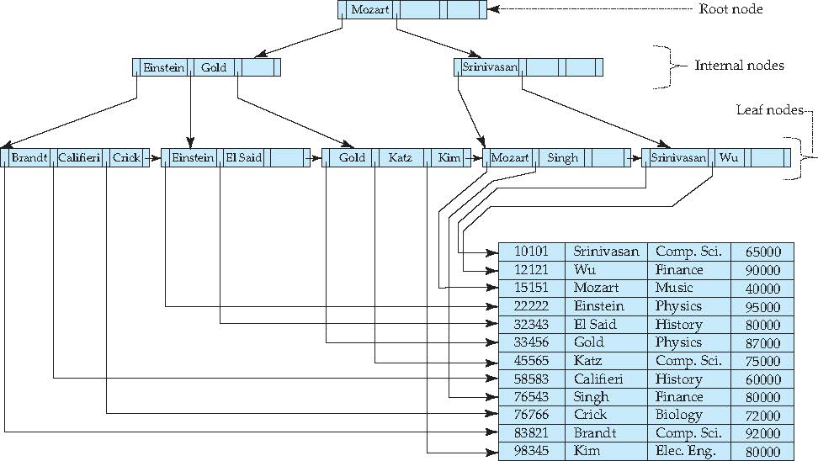
Instructor数据文件的B⁺树索引

Slide 26
B+树的性质
A B⁺-tree is a rooted tree satisfying the following properties:
All paths from root to leaf are of the same length
Each node that is not a root or a leaf has between ⎡n/2⎤ and n children.
A leaf node has between ⎡(n–1)/2⎤ and n–1 values
Special cases:
If the root is not a leaf, it has at least 2 children.
If the root is a leaf (that is, there are no other nodes in the tree), it can have between 0 and (n–1) values.

Slide 27
B⁺树的节点结构
Typical node
K_{i} are the search-key values
P_{i} are pointers to children (for non-leaf nodes) or pointers to records or buckets of records (for leaf nodes).
The search-keys in a node are ordered
K₁ < K₂ < K₃ < . . . < K_{n–1}
(Initially assume no duplicate keys, address duplicates later)

Slide 28
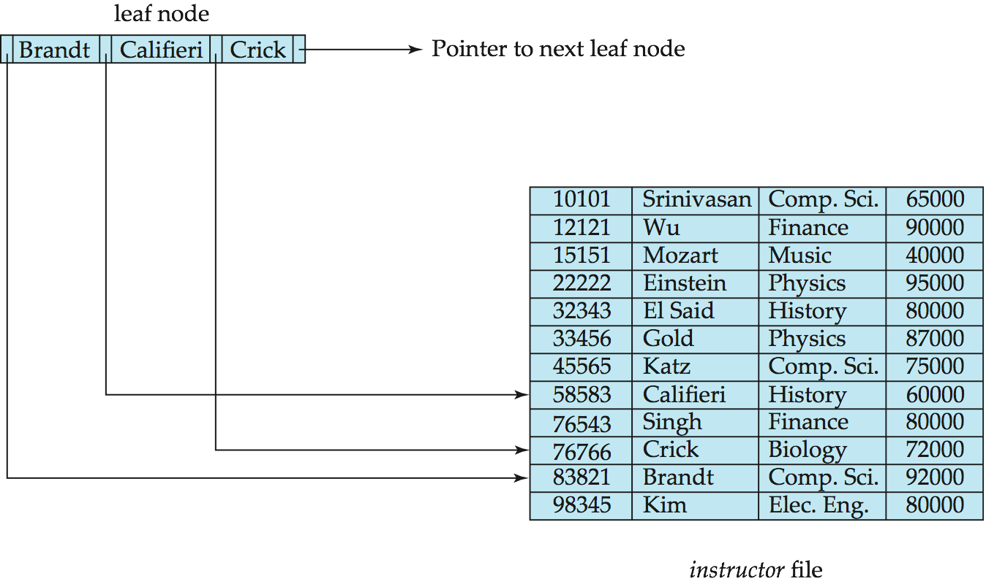
B⁺树的叶子节点
For i = 1, 2, . . ., n–1, pointer P_{i} points to a data file record with search-key value K_{i},
P_{n} points to next leaf node in search-key order
If L_{i}, L_{j} are leaf nodes and i < j, L_{i}’s search-key values are less than or equal to L_{j}’s search-key values
Instructor data file

Slide 29
B⁺树的非叶子节点
Non-leaf nodes form a multi-level sparse index on the leaf nodes.
For a non-leaf node with m pointers:
All the search-keys in the subtree to which P₁ points are less than K₁
For 2 ≤ i ≤ n – 1, all the search-keys in the subtree to which P_{i} points have values greater than or equal to K_{i–1} and less than K_{i}
All the search-keys in the subtree to which P_{n} points have values greater than or equal to K_{n–1}
<
>=
<
>=

Slide 30
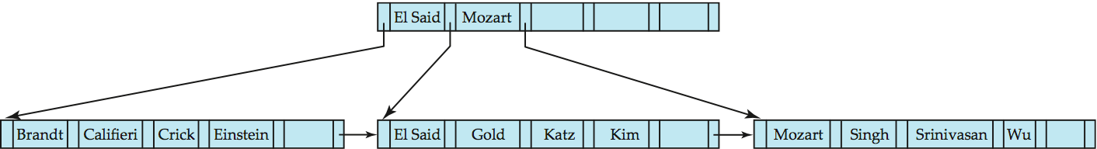
度为6的B⁺树
B⁺-tree for instructor file (n = 6)
Leaf nodes must have between 3 and 5 values (⎡(n–1)/2⎤ and n –1, with n = 6).
Non-leaf nodes other than root must have between 3 and 6 children (⎡(n/2⎤ and n with n =6).
Root must have at least 2 children.

Slide 31
B⁺树的高度
The B⁺-tree contains a relatively small number of levels
Level below root has at least 2* ⎡n/2⎤ values
Next level has at least 2* ⎡n/2⎤ * ⎡n/2⎤ values
.. etc.
If there are K search-key values in the file, the tree height is no more than ⎡ log_{⎡n/2⎤}(K)⎤
thus searches can be conducted efficiently.
Insertions and deletions to the main file can be handled efficiently, as the index can be restructured in logarithmic time (as we shall see).

Slide 32
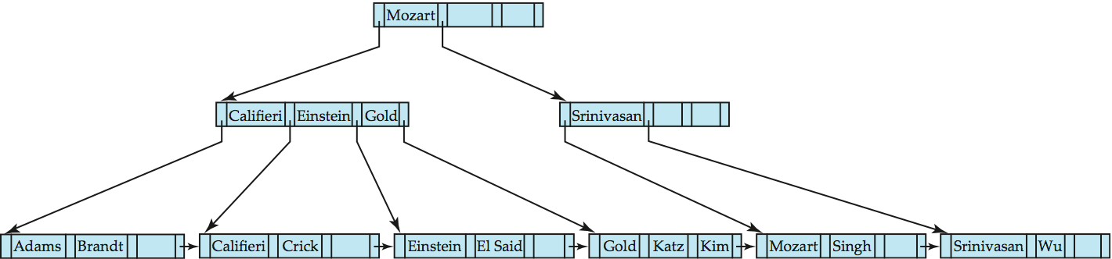
B⁺树的查询过程
Find record with search-key value V.
C=root
While C is not a leaf node { //非叶子节点
Let i be least value s.t. V ≤ K_{i}.
If no such number i exists, set C = last non-null pointer in C
Else { if (V= K_{i} ) Set C = P_{i +1} else set C = P_{i}}
}
Let j be least value s.t. K_{j} = V in the leaf node // 叶子节点
If there is such a value j, follow pointer P_{i} to the desired record,
Else no record with search-key value k exists
Find record ‘Wu’
Notes:
用Wu

Slide 33
B⁺树查询复杂度
If there are K search-key values in the file, the height of the tree is no more than ⎡log_{⎡n/2⎤}(K)⎤.
A node is generally the same size as a disk block, typically 4 kilobytes, and n is typically around 100 (40 bytes per index entry).
With 1 million search key values and n = 100
at most log₅₀(1,000,000) = 4 nodes are accessed in a lookup.
Contrast this with a balanced binary tree with 1 million search key values — around 20 nodes are accessed in a lookup

Slide 34
B⁺树插入算法
Find the leaf node in which the search-key value would appear
If the search-key value is already present in the leaf node
Add record to the file
If necessary add a pointer to the bucket.
If the search-key value is not present, then
add the record to the data file (and create a bucket if necessary)
If there is room in the leaf node, insert (key-value, pointer) pair in the leaf node
Otherwise, split the node (along with the new (key-value, pointer) entry) as discussed in the next slide.

Slide 35
叶子节点分裂
take the n (search-key value, pointer) pairs (including the one being inserted) in sorted order. Place the first ⎡n/2⎤ in the original node, and the rest in a new node(右边节点）.
let the new node be p, and let k be the least key value in p. Insert (k,p) in the parent of the node being split.
If the parent is full, split it and propagate the split further up.
new-node
Result of splitting node containing Brandt, Califieri and Crick on inserting Adams
Next step: insert entry with (Califieri,pointer-to-new-node) into parent

Slide 36
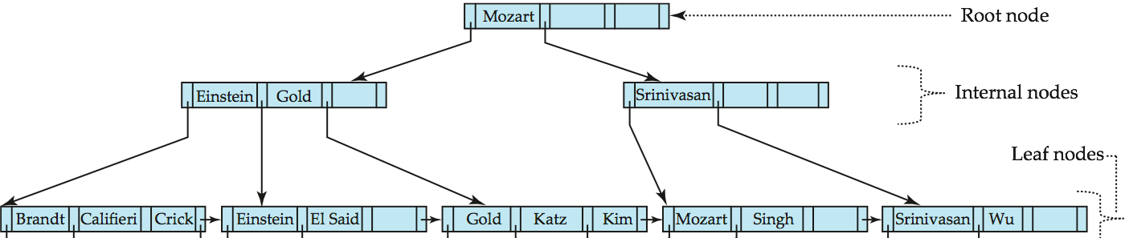
Insertion of “Adams”
2
Califieri
Adams
1
插入记录
new node
B⁺-Tree before and after insertion of “Adams”

Slide 37
非叶子节点分裂
when inserting (k,p) into an already full internal node N
Copy N to an in-memory area M with space for n+1 pointers and n keys
Insert (k,p) into M
Copy P₁,K₁, …, K _{⎡n+1/2⎤-1},P _{⎡n+1/2⎤} from M back into node N
Copy P_{⎡n+1/2⎤+1},K _{⎡n+1/2⎤+1},…,K_{n},P_{n+1} from M into newly allocated node N’
Insert (K _{⎡n+1/2⎤},N’) into parent N

Slide 38
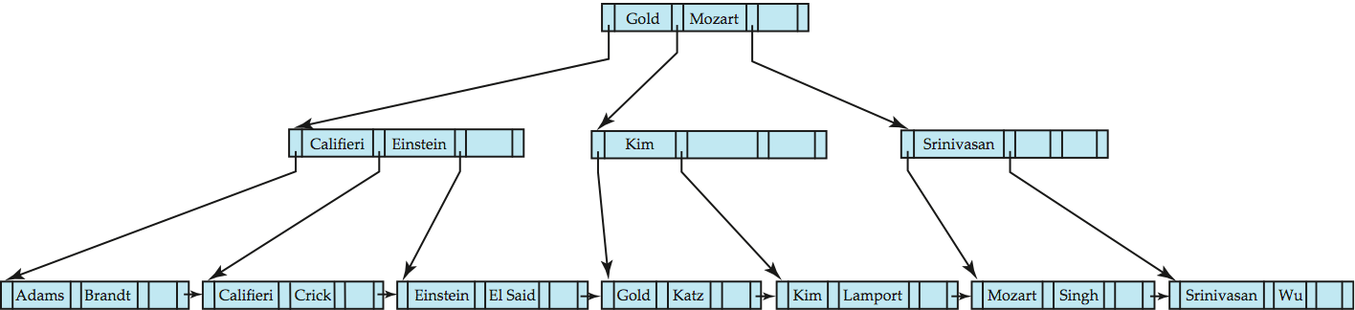
Insertion of “Lamport”
(K _{⎡n+1/2⎤},N’)
Gold
M
5
1
Kim
2
Lamport
插入记录
N
4
N’
3

Slide 39
B⁺树节点删除算法：合并
Find the record to be deleted, and remove it from the data file
Remove (search-key value, pointer) from the leaf node if there is no record in the data file
If the node has too few entries due to the removal, and the entries in the node and a sibling fit into a single node, then merge siblings:
Insert all the search-key values in the two nodes into a single node (the one on the left), and delete the other node.
Delete the pair (K_{i–1}, P_{i}), where P_{i} is the pointer to the deleted node, from its parent, recursively using the above procedure.

Slide 40
B⁺树节点删除算法：重分布
Otherwise, if the node has too few entries due to the removal, but the entries in the node and a sibling do not fit into a single node, then redistribute pointers:
Redistribute the pointers between the node and a sibling such that both have more than the minimum number of entries.
Update the corresponding search-key value in the parent of the node.
The node deletions may cascade upwards till a node which has ⎡n/2⎤ or more pointers is found.
If the root node has only one pointer after deletion, it is deleted and the sole child becomes the root.

Slide 41
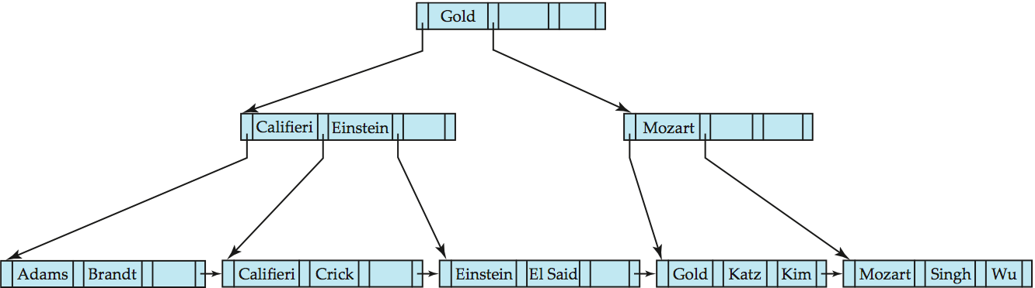
Deleting “Srinivasan”
2
重分布
Before deleting “Srinivasan”
1
合并

Slide 42
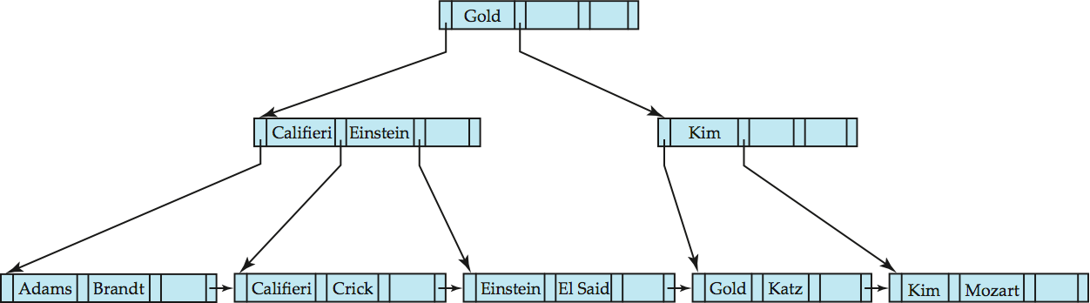
Deleting “Singh and Wu”
Before deleting “Singh” and “Wu”
1
重分布
Search-key value in the parent changes as a result
Leaf became underfull, and borrowed a value Kim from its left sibling

Slide 43
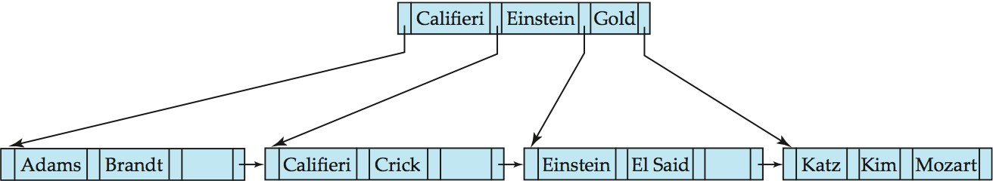
B⁺树删除后影响高度
1
合并
Before and after deletion of “Gold” from earlier example
Node with Gold and Katz became underfull, and was merged with its sibling
Parent node becomes underfull, and is merged with its sibling
Value separating two nodes (at the parent) is pulled down when merging
Root node then has only one child, and is deleted

Slide 44
Contents
Basic Concepts
Ordered Indices
B+-Tree Index Files
B+-Tree File Organization
Static Hashing
Dynamic Hashing
Comparison of Ordered Indexing and Hashing
Bitmap Indices
Index Definition in SQL

Slide 45
B⁺树文件组织
B⁺-Tree indices vs B⁺-Tree File Organization.
The leaf nodes in a B⁺-tree file organization store records, instead of pointers.
Leaf nodes are still required to be half full
Since records are larger than pointers, the maximum number of records that can be stored in a leaf node is less than the number of pointers in a nonleaf node.
Insertion and deletion are handled in the same way as insertion and deletion of entries in a B⁺-tree index.

Slide 46
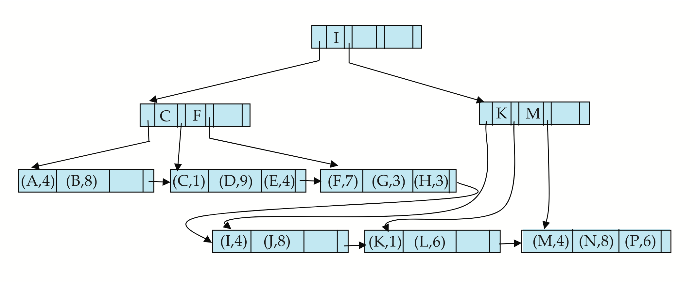
B⁺树文件的层次结构
每个节点即数据块中的元组具体怎样存放呢？

Slide 47
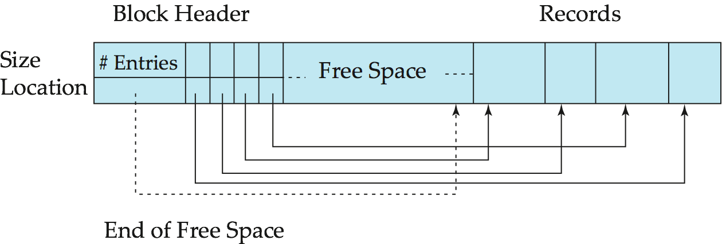
槽页结构——Slotted Page Structure
Slotted page header contains:
number of record entries
end of free space in the block
location and size of each record
Records can be moved around within a page to keep them contiguous with no empty space between them; entry in the header must be updated.
Pointers should not point directly to record — instead they should point to the entry for the record in header.

Slide 48
Contents
Basic Concepts
Ordered Indices
B+-Tree Index Files
B+-Tree File Organization
Static Hashing
Dynamic Hashing
Comparison of Ordered Indexing and Hashing
Bitmap Indices
Index Definition in SQL

Slide 49
静态哈希索引
A bucket is a unit of storage containing one or more records (a bucket is typically a disk block).
In a hash file organization we obtain the bucket of a record directly from its search-key value using a hash function.
Hash function h is a function from the set of all search-key values K to the set of all bucket addresses B.
Hash function is used to locate records for access, insertion as well as deletion.
Notes:
Records with different search-key values may be mapped to the same bucket; thus entire bucket has to be searched sequentially to locate a record.

Slide 50
哈希数据文件
There are 8 buckets,
The binary representation of the i_{th} character is assumed to be the integer j.
The hash function returns the sum of the binary representations of the characters modulo 8
E.g. h(Music) = 1 h(History) = 2 h(Physics) = 3 h(Elec. Eng.) = 3

Slide 51

哈希数据文件举例
Hash file organization of instructor file, using dept_name as key (see previous slide for details).

Slide 52
哈希函数
Worst hash function maps all search-key values to the same bucket
An ideal hash function is uniform, i.e., each bucket is assigned the same number of search-key values from the set of all possible values.
Ideal hash function is random, so each bucket will have the same number of records assigned to it irrespective of the actual distribution of search-key values in the file.
For example, for a string search-key, the binary representations of all the characters in the string could be added and the sum modulo the number of buckets could be returned. .

Slide 53
桶的溢出
Bucket overflow can occur because of
Insufficient buckets
Skew in distribution of records. This can occur due to two reasons:
multiple records have same search-key value
chosen hash function produces non-uniform distribution of key values
Although the probability of bucket overflow can be reduced, it cannot be eliminated; it is handled by using overflow buckets.

Slide 54
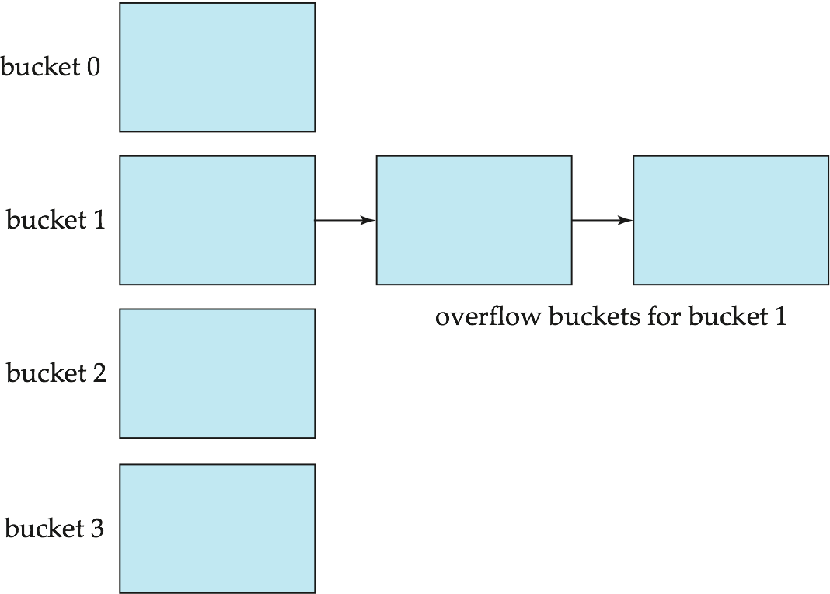
开地址策略
Overflow chaining – the overflow buckets of a given bucket are chained together in a linked list.
Above scheme is called open addressing/ closed hashing.
Notes:
An alternative, called closed addressing/open hashing, which does not use overflow buckets, e.g. liner probing(线性探测), is not suitable for database applications.

Slide 55
哈希索引文件
Hashing can be used not only for data file organization, but also for index-structure creation.
A hash index organizes the search keys, with their associated record pointers, into a hash file structure.
Strictly speaking, hash indices are always secondary indices
if the file itself is organized using hashing, a separate primary hash index on it using the same search-key is unnecessary.
However, we use the term hash index to refer to both secondary index structures and hash organized files.

Slide 56
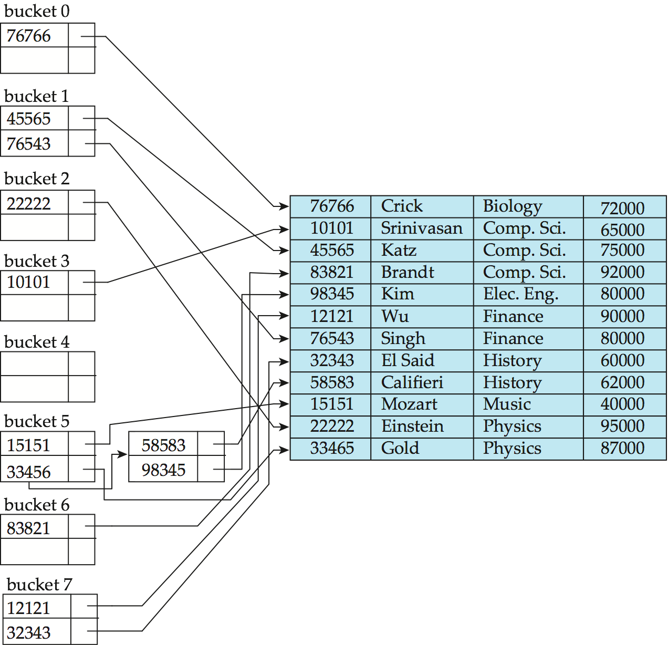
哈希索引举例
hash index on instructor, on attribute ID

Slide 57
静态哈希的缺点
In static hashing, function h maps search-key values to a fixed set of B of bucket addresses. Databases grow or shrink with time.
If initial number of buckets is too small, and file grows, performance will degrade due to too much overflows.
If space is allocated for anticipated growth, a significant amount of space will be wasted initially (and buckets will be underfull).
If database shrinks, again space will be wasted.
怎样估计B的值？fudge factor - 负载因子
Better solution: allow the number of buckets to be modified dynamically.

Slide 58
Contents
Basic Concepts
Ordered Indices
B+-Tree Index Files
B+-Tree File Organization
Static Hashing
Dynamic Hashing
Comparison of Ordered Indexing and Hashing
Bitmap Indices
Index Definition in SQL

Slide 59
动态哈希
Good for database that grows and shrinks in size
Extendable hashing – one form of dynamic hashing
Hash function generates values over a large range — typically b-bit integers, with b = 32.
At any time use only a prefix of the hash function to index into a table of bucket addresses.
Let the length of the prefix be i bits, 0 ≤ i ≤ 32.
Bucket address table size（桶地址表规模） = 2^{i.} Initially i = 0
Value of i grows and shrinks as the size of the database grows and shrinks.
Multiple entries in the bucket address table may point to a bucket
Thus, actual number of buckets is < 2^{i}
The number of buckets also changes dynamically due to coalescing and splitting of buckets.

Slide 60
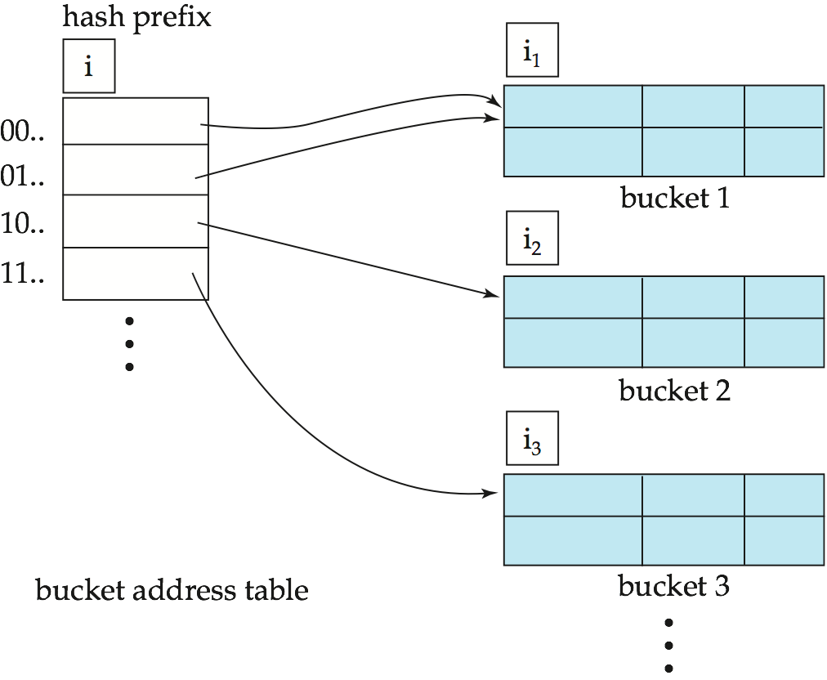
通用可扩展哈希结构
General Extendable Hashing Structure
Each bucket j stores a value i_{j} and all the entries that point to the same bucket have the same values on the first i_{j} bits.
In this structure, i₂ = i₃ = i, whereas i₁ = i – 1

Slide 61
查询与插入
To locate the bucket containing search-key K_{j}:
1. Compute h(K_{j}) = X
2. Use the first i high order bits of X as a displacement（偏移地址） into bucket address table, and follow the pointer to appropriate bucket
To insert a record with search-key value K_{j}
follow same procedure as look-up and locate the bucket, say j.
If there is room in the bucket j insert record in the bucket.
Else the bucket must be split and insertion re-attempted (见下页)
Overflow buckets used instead in some cases

Slide 62
分裂算法
To split a bucket j when inserting record with search-key value K_{j}:
If i > i_{j} (more than one pointer to bucket j)
allocate a new bucket z, and set i_{j} = i_{z} = (i_{j} + 1)
Update the second half of the bucket address table entries originally pointing to j, to point to z
remove each record in bucket j and reinsert (in j or z)
recompute new bucket for K_{j} and insert record in the bucket (further splitting is required if the bucket is still full)

Slide 63
分裂算法
To split a bucket j when inserting record with search-key value K_{j}:
If i = i_{j} (only one pointer to bucket j)
If i reaches some limit b, or too many splits have happened in this insertion, create an overflow bucket
Else
increment i and double the size of the bucket address table.
replace each entry in the table by two entries that point to the same bucket.
recompute new bucket address table entry for K_{j} Now i > i_{j} so use the first case above.

Slide 64
删除算法
locate it in its bucket and remove it.
The bucket itself can be removed if it becomes empty (with appropriate updates to the bucket address table).
Coalescing of buckets can be done (can coalesce only with a “buddy” bucket having same value of i_{j} and same i_{j} –1 prefix, if it is present)
Decreasing bucket address table size is also possible
Note: decreasing bucket address table size is an expensive operation and should be done only if number of buckets becomes much smaller than the size of the table

Slide 65
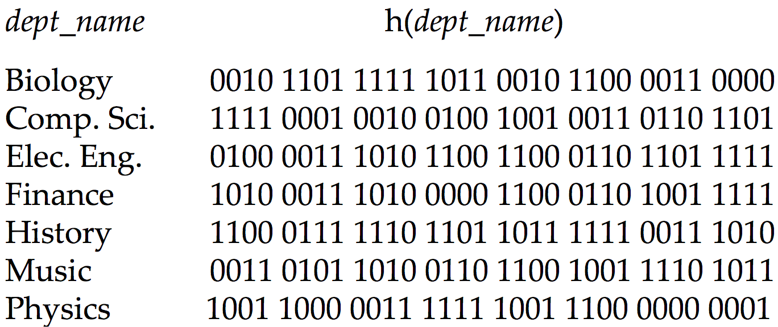
动态哈希举例

Slide 66
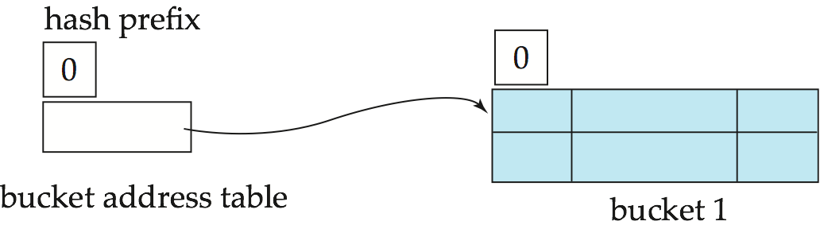
Example (c1)
Initial Hash structure; bucket size = 2

Slide 67
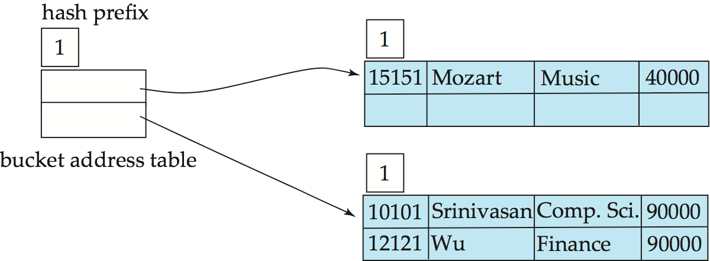
Example (c2)
Hash structure after insertion of “Mozart”, “Srinivasan”, and “Wu” records

Slide 68
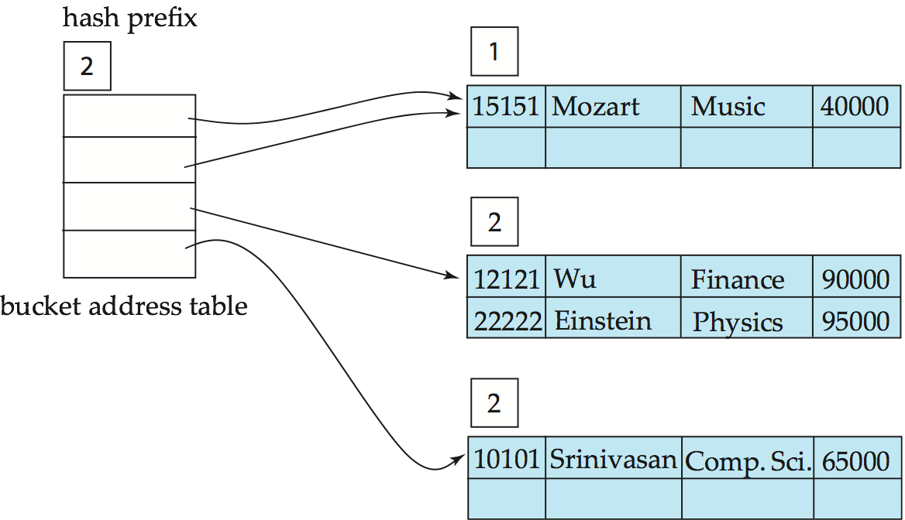
Example (c3)
Hash structure after insertion of Einstein record

Slide 69
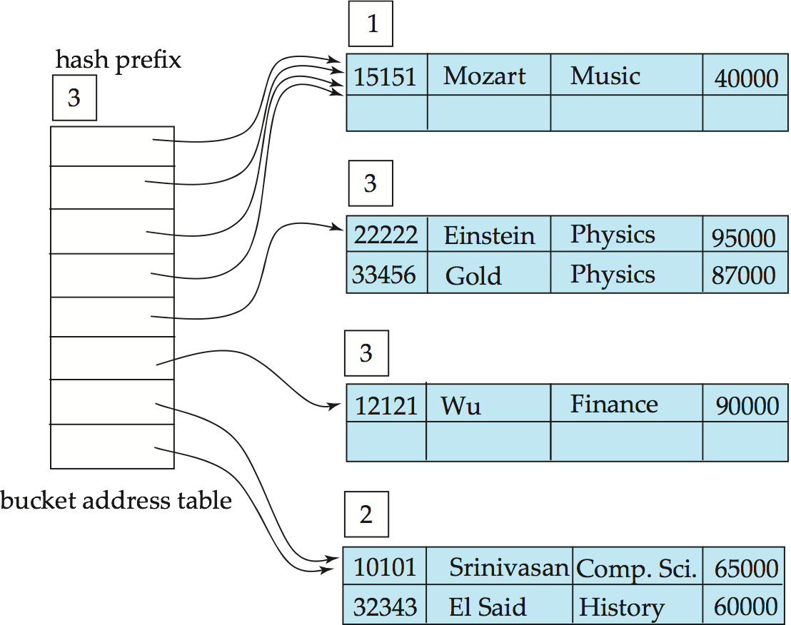
Example (c4)
Hash structure after insertion of Gold and El Said records

Slide 70
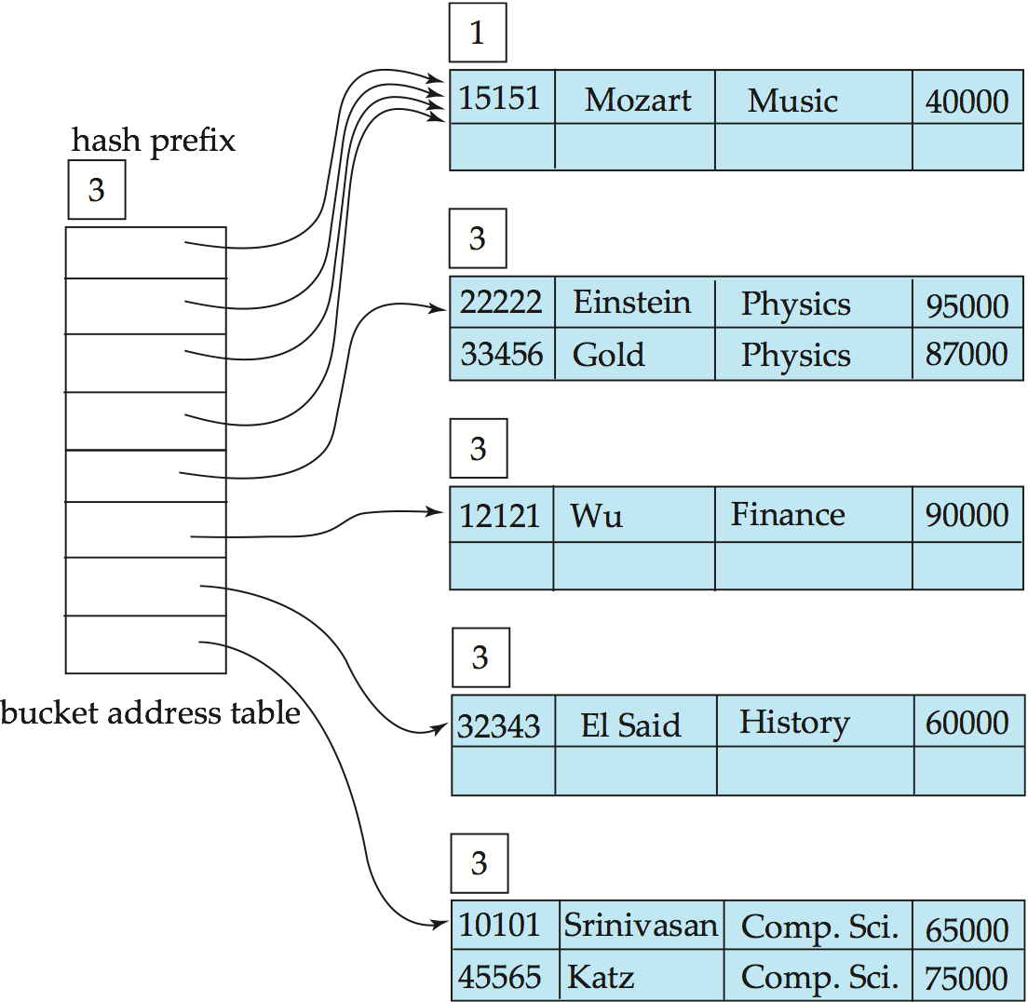
Example (c5)
Hash structure after insertion of Katz record

Slide 71
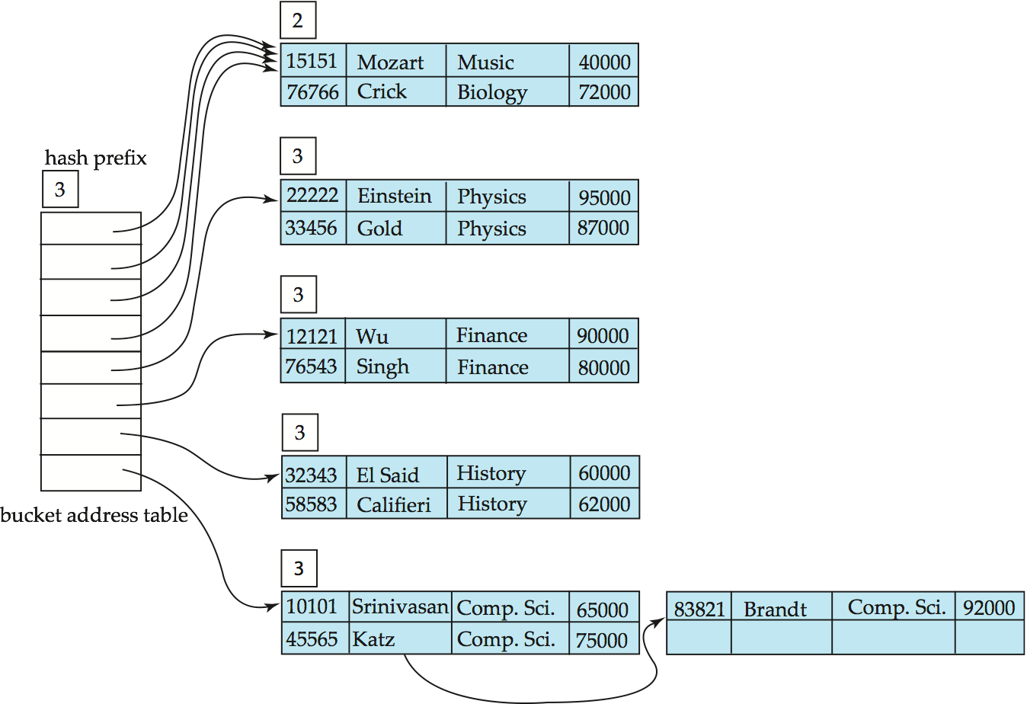
Example (c6)
And after insertion of
eleven records

Slide 72
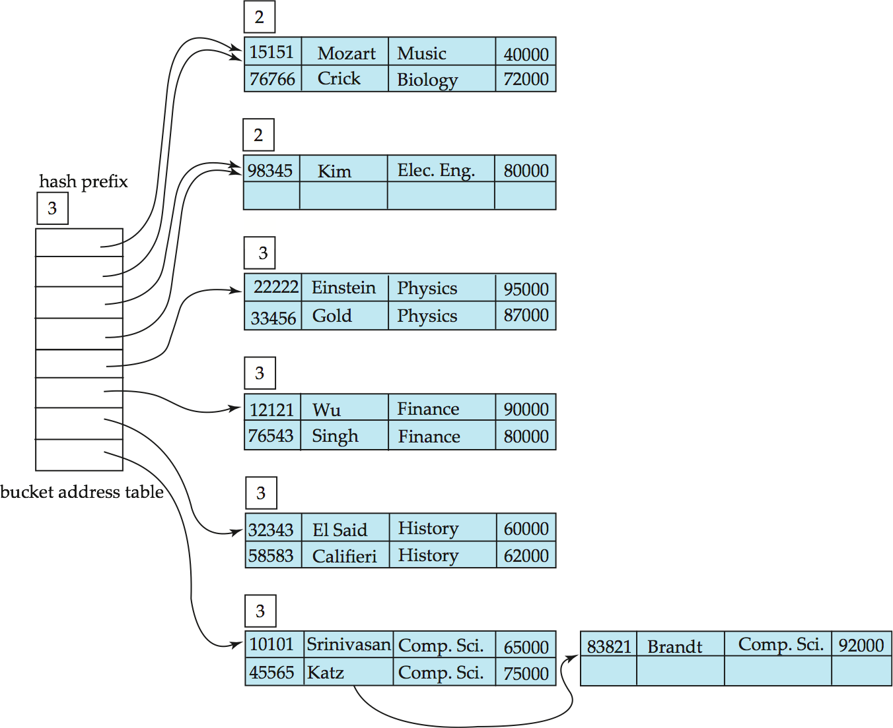
Example (c7)
And after insertion of
Kim record in previous
hash structure

Slide 73
可扩展哈希的讨论
Benefits of extendable hashing:
Hash performance does not degrade with growth of file
Minimal space overhead
Disadvantages of extendable hashing
Extra level of indirection to find desired record
Bucket address table may itself become very big (larger than memory)
Cannot allocate very large contiguous areas on disk either
Solution: B⁺-tree structure to locate desired record in bucket address table
Changing size of bucket address table is an expensive operation

Slide 74
Contents
Basic Concepts
Ordered Indices
B+-Tree Index Files
B+-Tree File Organization
Static Hashing
Dynamic Hashing
Comparison of Ordered Indexing and Hashing
Bitmap Indices
Index Definition in SQL

Slide 75
顺序索引与哈希索引
Cost of periodic re-organization
Relative frequency of insertions and deletions
Is it desirable to optimize average access time at the expense of worst-case access time?
Expected type of queries:
Hashing is generally better at retrieving records having a specified value of the key.
If range queries are common, ordered indices are to be preferred
In practice:
PostgreSQL supports hash indices, but discourages use due to poor performance
Oracle supports static hash organization, but not hash indices
SQLServer supports only B⁺-trees

Slide 76
Contents
Basic Concepts
Ordered Indices
B+-Tree Index Files
B+-Tree File Organization
Static Hashing
Dynamic Hashing
Comparison of Ordered Indexing and Hashing
Bitmap Indices
Index Definition in SQL

Slide 77
位图索引
Bitmap indices are a special type of index designed for efficient querying on multiple keys
Records in a relation are assumed to be numbered sequentially from, say, 0
Given a number n it must be easy to retrieve record n
Particularly easy if records are of fixed size
Applicable on attributes that take on a relatively small number of distinct values
E.g. gender, country, state, …
E.g. income-level (income broken up into a small number of levels such as 0-9999, 10000-19999, 20000-50000, 50000- infinity)
A bitmap is simply an array of bits

Slide 78
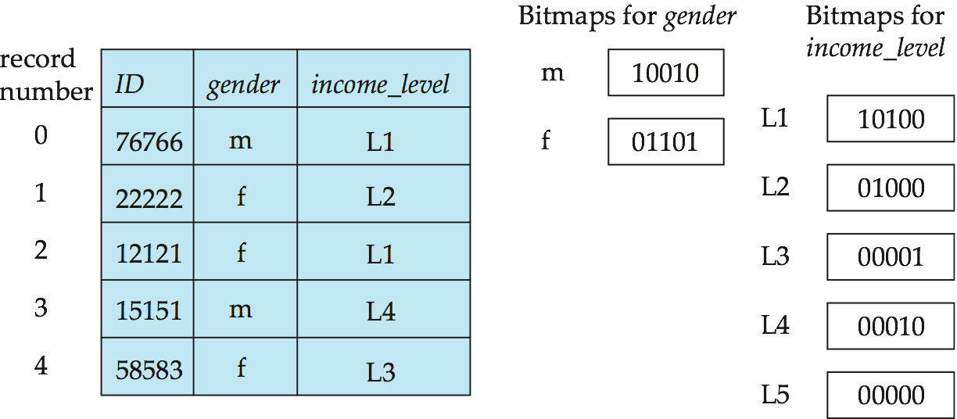
位图索引举例
In its simplest form a bitmap index on an attribute has a bitmap for each value of the attribute
Bitmap has as many bits as records
In a bitmap for value v, the bit for a record is 1 if the record has the value v for the attribute, and is 0 otherwise
Notes:
一定要看懂位图串

Slide 79
位图索引查询
Bitmap indices are useful for queries on multiple attributes
not particularly useful for single attribute queries
Queries are answered using bitmap operations
Intersection (and)
Union (or)
Complementation (not)
Each operation takes two bitmaps of the same size and applies the operation on corresponding bits to get the result bitmap
E.g. 100110 AND 110011 = 100010
OR 110011 = 110111 NOT 100110 = 011001
Males with income level L1: 10010 AND 10100 = 10000
Can then retrieve required tuples.
Counting number of matching tuples is even faster

Slide 80
位图索引的操作
Bitmap indices generally very small compared with relation size
E.g. if record is 100 bytes, space for a single bitmap is 1/800 of space used by relation.
If number of distinct attribute values is 8, bitmap is only 1% of relation size
Deletion needs to be handled properly
Existence bitmap to note if there is a valid record at a record location
Needed for complementation
not(A=v): (NOT bitmap-A-v) AND ExistenceBitmap
Should keep bitmaps for all values, even null value
To correctly handle SQL null semantics for NOT(A=v):
intersect above result with (NOT bitmap-A-Null)

Slide 81
Contents
Basic Concepts
Ordered Indices
B+-Tree Index Files
B+-Tree File Organization
Static Hashing
Dynamic Hashing
Comparison of Ordered Indexing and Hashing
Bitmap Indices
Index Definition in SQL

Slide 82
SQL索引语句
Create an index
create index <index-name> on <relation-name> (<attribute-list>)
E.g.: create index b-index on branch(branch_name)
Use create unique index to indirectly specify and enforce the condition that the search key is a candidate key.
Not really required if SQL unique integrity constraint is supported

Slide 83
SQL索引语句
Most database systems allow specification of type of index，such as B+-tree or hashing.
Some database systems also permit one of the indices on a relation to be declared to be clustered; the system then stores the relation sorted by the search-key of the clustered index
To drop an index
drop index <index-name>

Slide 84
End of Chapter

